Slide 1
Explore the 2019 CCRPI for
Elementary and Middle School

Slide 2
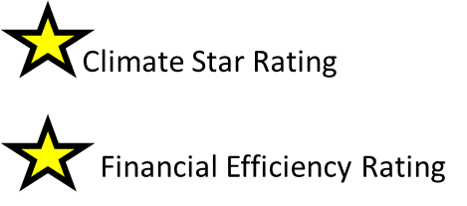
2019 CCRPI
What does it address?
Elementary /Middle
4 Components
Content Mastery
Progress
How much growth are students demonstrating relative to academically-similar students?
Closing Gaps (Flags)
Readiness
Graduation Rate
(HS only)
Are students graduating from HS with a regular diploma in four or five years? Graduation Rate is included only in High School CCRPI.
Are students achieving at the level necessary to be prepared for the next grade, college, or career?
Are all students and all student subgroups making improvements in achievement rates?
Are students participating in activities preparing them for and demonstrating readiness for the next level, college, or career?
Source 1
Intro slide 1 of 3

Slide 3
2019 CCRPI
How is it scored?
Elementary/ Middle
4 Components
11 Indicators
Content Mastery
30 pts
Progress
35 pts
5. ELA Student Growth Percentile (SGP)
6. Math Student Growth Percentile (SGP)
7. EL Students’ Progress on ACCESS Exam
Closing Gaps (Flags)
15 pts
Readiness
20 pts
1. ELA Achievement
2. Math Achievement
3. Science Achievement
4. Social Studies Achievement
8. Extent to which ALL Students and Subgroups meet Improvement Targets
(3% Improvement on School’s 2017 Achievement Scores)
9. Literacy – Lexile
10. Student Attendance - <10% of enrolled days
11. Beyond the Core Elem (Fine Arts/World Lang)
Beyond the Core Middle (FA/WL/PE/Health/Career Exp)
Graduation Rate
(HS only)
Total 100 pts
Source 1, 4
Intro slide 2 of 3

Slide 4
Scoring Sample
Content Mastery
30 pts (30/30=100)*
Progress
35 pts (35/35=100)*
30.98/35 =
Closing Gaps (Flags)
15 pts (15/15=100)*
Readiness
20 pts
(20/20= 100)*
24.96/30 =
10.19/15 =
16.98/20 =
83.2*
88.5*
67.9*
84.9*
Elementary /Middle
4 Components
11 Indicators
*Because people understand base 10, each component will also be reported as a score out of 100.
Climate Star Rating
Graduation Rate
(HS only)
Total CCRPI = 83.1
Financial Efficiency Rating
Source 1, 4
Intro slide 3 of 3

Slide 5

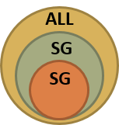
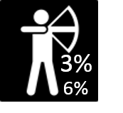
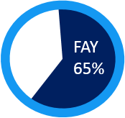
How to navigate the rest of this presentation:
The next slide is a menu slide, like a table of contents. You can return the menu slide at any time by clicking on this button.
On the MENU slide, click on the colored boxes (components of the CCRPI) to explore that component of the CCRPI.
Most slides have icons with pop-up or interactive features. For example….
When clicked, these icons provide definitions of terms, or brief examples, or sources of data.
An icon is included on a slide only if it represents a factor that impacts that component of the CCRPI.
Most slides have a source number in the lower, left-hand corner. A bibliography at the end of the presentation includes a citation for each source number and a link if the source is available online.

Slide 6
menu
Content Mastery
30
ELA
37.5% (11.25 pts)
Math
37.5% (11.25 pts)
SC
12.5% (3.75 pts)
SS
12.5% (3.75 pts)
Click on button to return to this slide
Progress
35
ELA
45% (15.75 pts)
Math
45% (15.75 pts)
ACCESS
10%
(3.5 pts)*
4 Components
11 Indicators
100 pts
Closing Gaps (Flags)
15
Math
SC
SS
ELA
Readiness
20
Literacy - Lexile
33.33% (6.7 pts)
Attendance
33.33% (6.7 pts)
BTC
33.33% (6.7 pts)
Explore components by clicking on boxes.
*If EL subgroup is < 15, the ACCESS points (3.5) are equally distributed between ELA and Math, making each of them = 50% or 17.5 pts.
6
Source 1, 4
Menu slide 1 of 1
Notes:
6

Slide 7

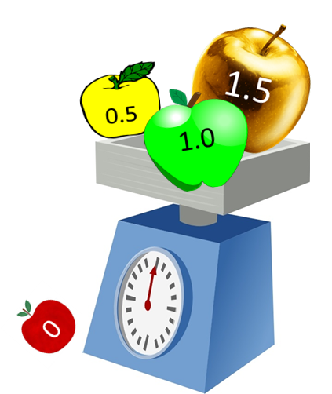
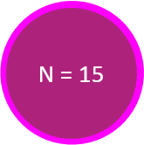
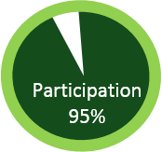


Content Mastery
30 pts
Content Mastery
30 %(pts)
Progress
35 %(pts)
Closing Gaps (Flags)
15 %(pts)
Readiness
20 %(pts)
Graduation Rate
(HS only)
ELA
37.5% (11.25 pts)
Math
37.5% (11.25 pts)
SC
12.5% (3.75 pts)
SS
12.5% (3.75 pts)
10 Reporting Categories
1. ALL students
2. Am Indian/Alaskan
3. Asian/Pac Islander
4. Black
5. Hispanic
6. Multi-Racial
7. White
8. Econ-Disadv (ED)
9. English Learner (EL)
10.Stud w/ Disab (SWD)
(click to close)
  ELA EOG score (3-5 , 6-8)
  Math EOG score (3-5 , 6-8)
  Science EOG score (5, 8 only)
  Social Studies EOG score (5, 8 only)
  GAA not over 1% can be included
  EL scores included beginning in 3rd year
Weighting is a kind of average. Instead of each score contributing equally to the final average, some scores contribute more “weight” than others.
On the CCRPI, higher scores contribute more weight to the average than lower scores.
(click to close)
Full Academic Year = student is enrolled 65% of calendar days from year start date to close of GADOE testing window. Only FAY students are included in some CCRPI calculations.
(click to close)
GADOE requires that 95% of all students and 95% of any subgroup (N=15) participate in testing.
If participation falls below 95%, scores will be adjusted. (click to close)
Minimum subgroup size that must exist for scores to be included in CCRPI scoring and reporting.
(click to close)
Source 3
CM slide 1 of 2

Slide 8





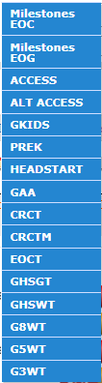
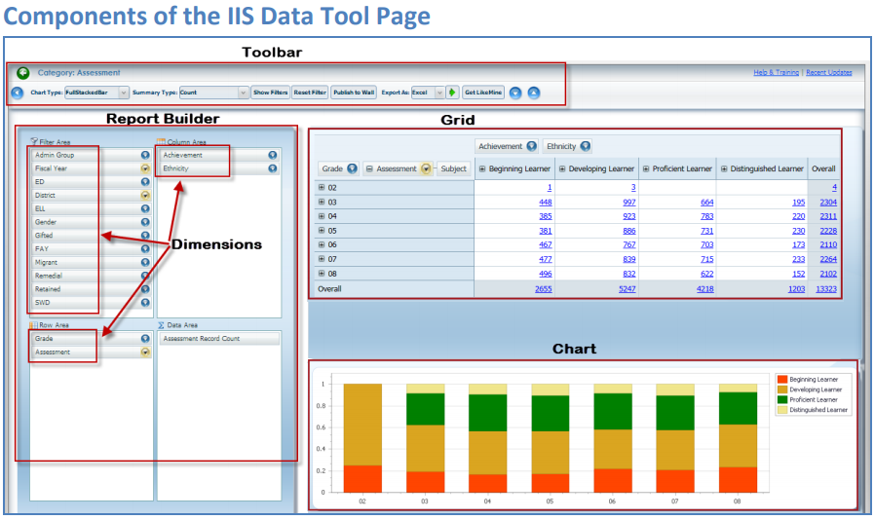
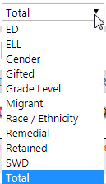
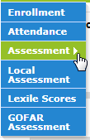
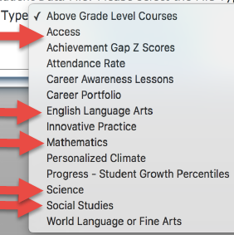
Data Sources for Content Mastery
GMAS EOG/EOC Data
GMAS Writing Data
-Down to Domains
-Filtered by Subgroups
-Analyze data by multiple dimensions simultaneously,
-Compare across years, districts and schools,
-Save and share reports and auto-generated charts,
-Export to Excel or PDF
Log in to
GADOE Portal
1. Select:
- “CCRPI Reports”
- “Data Details” TAB
- The desired file
2. Download file in Excel format
3. Filter according to GADOE Calculation Guide

Slide 9
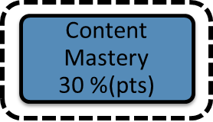

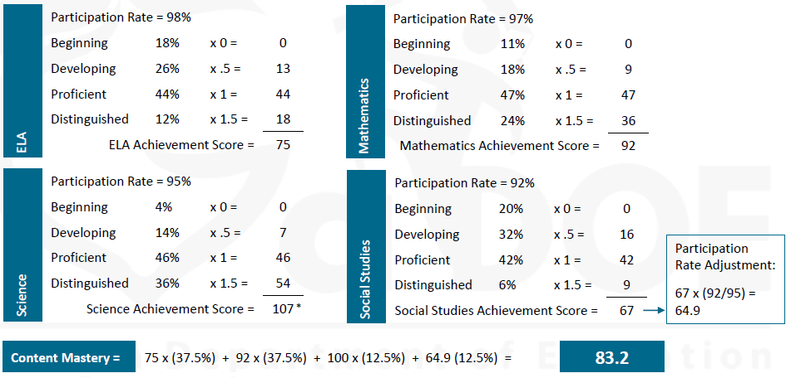
Example of Content Mastery Component
GADOE requires that 95% of all students and 95% of any subgroup (N=15) participate in testing.
If participation falls below 95%, scores will be adjusted. (click to close)
*scores capped at 100
(83.2) (.30) =
24.96 pts out of 30
Source 4
CM slide 2 of 2

Slide 10


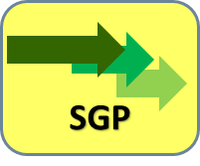

Progress
35 pts
Content Mastery
30 %(pts)
Progress
35 %(pts)
Closing Gaps (Flags)
15 %(pts)
Readiness
20 %(pts)
Graduation Rate
(HS only)
ELA
45% (15.75 pts)
Math
45% (15.75 pts)
ACCESS
10%
(3.5 pts)
Student Growth Percentiles measure progress in both ELA and Math based on at least 2 years of GMAS scores. An SGP is from 1 to 99.
SGPs represent the amount of growth a student has demonstrated in ELA or Math relative to academically-similar students. SGPs take into consideration students’ varying starting points when measuring growth during a school year.
EL students’ progress towards English language proficiency is measured using the ACCESS exam. Progress is defined as moving from one state-defined Performance Band to a higher Performance Band on this exam. An EL student’s Progress Score is included in CCRPI calculations beginning in the 2nd year.
Weighting is a kind of average. Instead of each score contributing equally to the final average, some scores contribute more “weight” than others.
On the CCRPI, higher scores contribute more weight to the average than lower scores.
(click to close)
Minimum subgroup size that must exist for scores to be included in CCRPI scoring and reporting.
(click to close)
Full Academic Year = student is enrolled 65% of calendar days from year start date to close of GADOE testing window. Only FAY students are included in some CCRPI calculations.
(click to close)
If EL subgroup doesn’t exist or
N < 15, the ACCESS points (3.5) are equally distributed between ELA and Math, making each of them = 50% or 17.5 pts. (click to close)
Source 4, 7
P slide 1 of 2

Slide 11
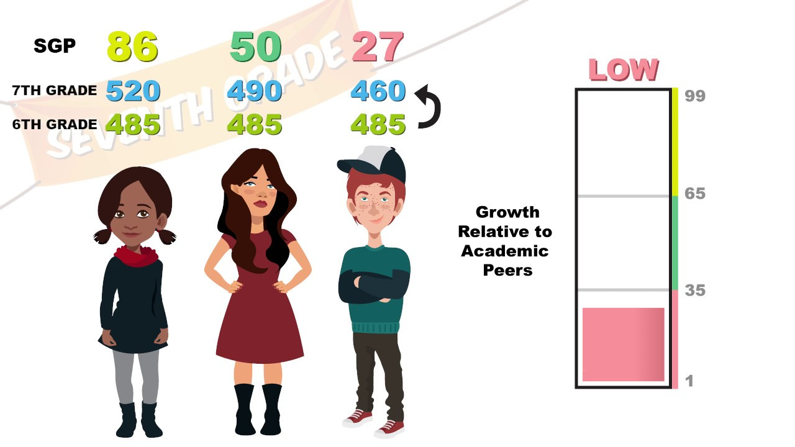
Student Growth Percentile (SGP) Illustration
Click to Close
All students made a 485 in 6th grade.
They made different scores in 7th grade.
An SGP of 86 shows
higher than average growth.
An SGP of 27 shows
lower than average growth.
Source 7

Slide 12
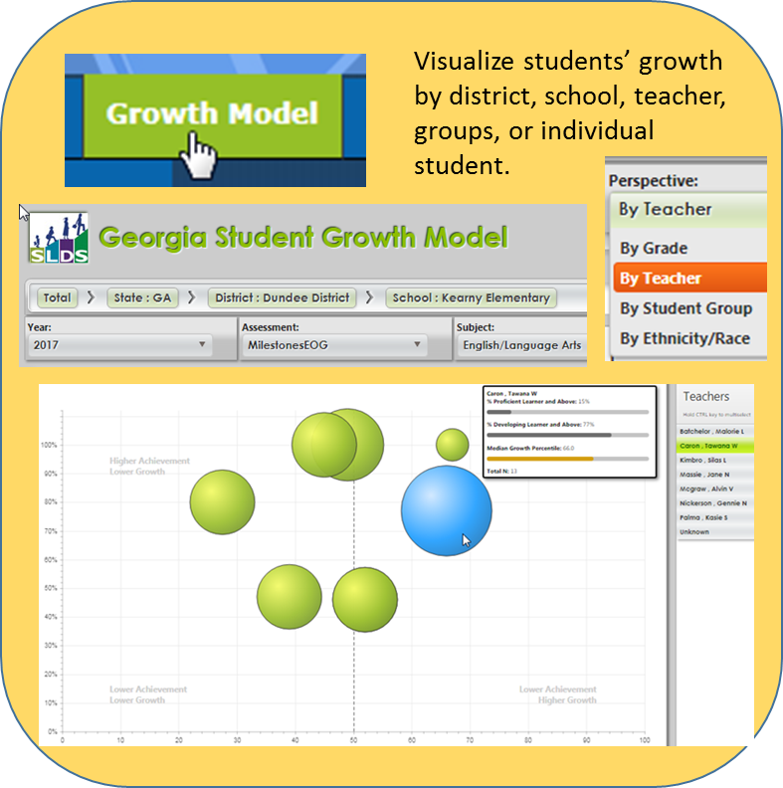
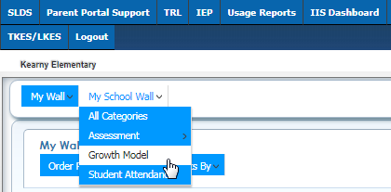

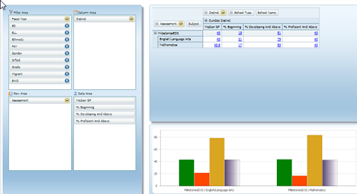
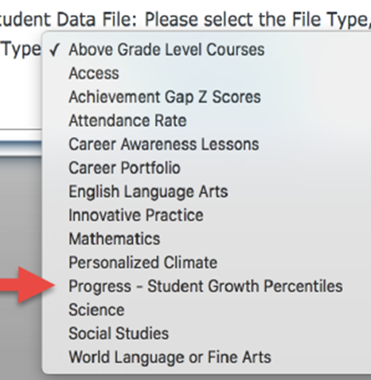
Data Sources for Progress
Click to Close
-Analyze data by multiple dimensions simultaneously,
-Compare across years, districts and schools,
-Save and share reports and auto-generated charts,
-Export to Excel or PDF
Log in to
GADOE Portal
1. Select:
- “CCRPI Reports”
- “Data Details” TAB
- The desired file
2. Download file in Excel format
3. Filter according to GADOE Calculation Guide

Slide 13
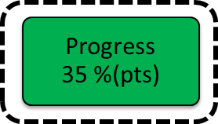
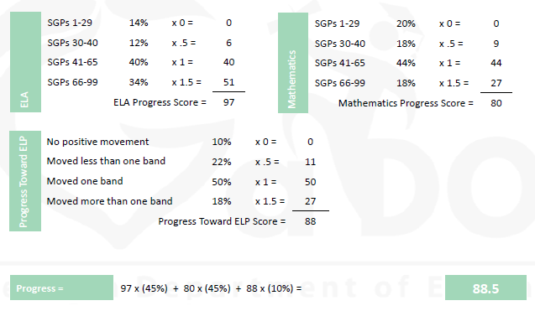
Example of Progress Component
Notes
EL students’ progress towards English language proficiency is measured using the ACCESS exam.
Progress is defined as moving from one state-defined Performance Band to a higher Performance Band on this exam.
An EL student’s Progress Score is included in CCRPI calculations beginning in the 2nd year.
(88.5) (.35) =
30.975 pts
out of 35
Source 4
P slide 2 of 2

Slide 14
Closing Gaps (Flags)
15 pts
Content Mastery
30 %(pts)
Progress
35 %(pts)
Closing Gaps (Flags)
15 %(pts)
Readiness
20 %(pts)
Graduation Rate (HS only)
ELA
Math
SC
SS
Example of Improvement Targets
3% 𝐼𝑚𝑝𝑟𝑜𝑣𝑒𝑚𝑒𝑛𝑡𝑇𝑎𝑟𝑔𝑒𝑡 = (100 − 𝑏𝑎𝑠𝑒𝑙𝑖𝑛𝑒2017) (0.03)
6% 𝐼𝑚𝑝𝑟𝑜𝑣𝑒𝑚𝑒𝑛𝑡𝑇𝑎𝑟𝑔𝑒𝑡 = (100 − 𝑏𝑎𝑠𝑒𝑙𝑖𝑛𝑒2017) (0.06)
Baseline2017 Score = 60
Improvement Target (3%)
Step 1: (100 –60) x .03 = 1.2
Step 2: 60 + 1.2 = 61.2
2018 Target Score = 61.2
Improvement Target (6%) (only ED,EL,SWD)
Step 1: (100 –60) x .06 = 2.4
Step 2: 60 + 2.4 = 62.4
2018 Target Score = 62.4
(click to close)
This component demonstrates schools’ and districts’ improvement by analyzing the change in students’ Content Mastery achievement scores from year to year in ELA, Math, SC, and SS.
  In in this component, achievement scores weigh equally. By contrast, in Content Mastery, achievement scores weigh as follows: ELA and Math weigh 75% while SC and SS weigh 25%.
  To measure improvement, 2017 achievement scores serve as a baseline. The baseline will reset every 5 years. The target for improvement by all students and subgroups of students is 3%.
  Weighting creates an incentive for 6% improvement among particular subgroups (ED, EL, SWD).
Flags graphically represent a school’s improvement. These are explained on the next slide.
10 Reporting Categories (Subgroups)
1. ALL students
2. Am Indian/Alaskan
3. Asian/Pacific Islander
4. Black
5. Hispanic
6. Multi-Racial
7. White
8. Econ-Disadvantaged (ED)
9. English Learner (EL)
10.Students w/ Disabilities (SWD)
(click to close)
Full Academic Year = student is enrolled 65% of calendar days from year start date to close of GADOE testing window. Only FAY students are included in some CCRPI calculations.
(click to close)
Minimum subgroup size that must exist for scores to be included in CCRPI scoring and reporting.
(click to close)
Source 4
CG slide 1 of 3

Slide 15

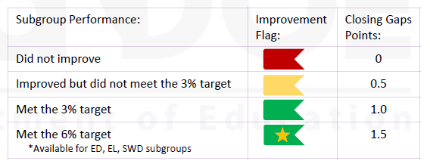
Closing Gaps (Flags)
15 pts
Content Mastery
30 %(pts)
Progress
35 %(pts)
Closing Gaps (Flags)
15 %(pts)
Readiness
20 %(pts)
Graduation Rate
(HS only)
Example of Improvement Targets
3% 𝐼𝑚𝑝𝑟𝑜𝑣𝑒𝑚𝑒𝑛𝑡𝑇𝑎𝑟𝑔𝑒𝑡 = (100 − 𝑏𝑎𝑠𝑒𝑙𝑖𝑛𝑒2017) (0.03)
6% 𝐼𝑚𝑝𝑟𝑜𝑣𝑒𝑚𝑒𝑛𝑡𝑇𝑎𝑟𝑔𝑒𝑡 = (100 − 𝑏𝑎𝑠𝑒𝑙𝑖𝑛𝑒2017) (0.06)
Baseline2017 Score = 60
Improvement Target (3%)
Step 1: (100 –60) x .03 = 1.2
Step 2: 60 + 1.2 = 61.2
2018 Target Score = 61.2
Improvement Target (6%) (only ED,EL,SWD)
Step 1: (100 –60) x .06 = 2.4
Step 2: 60 + 2.4 = 62.4
2018 Target Score = 62.4
(click to close)
10 Reporting Categories (Subgroups)
1. ALL students
2. Am Indian/Alaskan
3. Asian/Pacific Islander
4. Black
5. Hispanic
6. Multi-Racial
7. White
8. Econ-Disadvantaged (ED)
9. English Learner (EL)
10.Students w/ Disabilities (SWD)
(click to close)
Math
SC
SS
ELA
Flags will be reported for ALL students and for each subgroup.
Source 4
CG slide 2 of 3

Slide 16
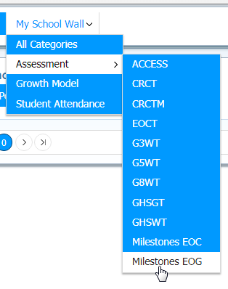

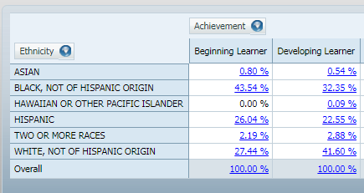
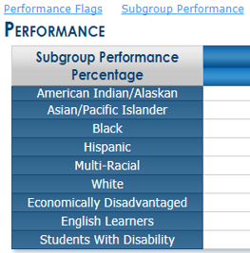
Data Sources for Closing Gaps / Flags
Click to Close
-Analyze data by multiple dimensions simultaneously,
-Compare across years, districts and schools,
-Save and share reports and auto-generated charts,
-Export to Excel or PDF
Log in to
GADOE Portal
1. Select:
- “CCRPI Reports”
“Performance Flags” Tab
2. Click on hotlinks for
- “Subgroup Performance”
-”Performance Targets” for 3% and 6% Targets
GMAS EOG/EOC Data
GMAS Writing Data
-Down to Domains
-Filtered by Subgroups

Slide 17
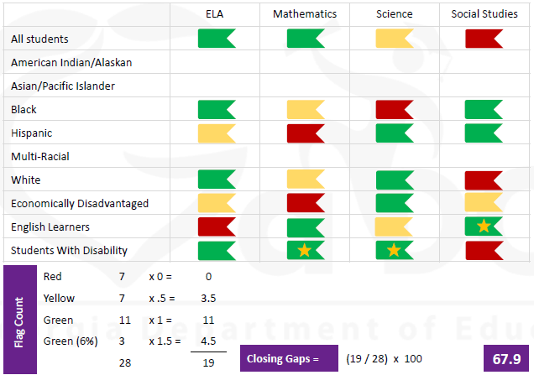
Example of
Closing Gaps
(Flags)
15 pts
Closing Gaps (Flags)
15 %(pts)
ELA
Math
SC
SS
SWD, ED, EL only, if reach 6% target
(67.9) (.15) =
10.19 pts
out of 15
Source 4
CG slide 3 of 3

Slide 18



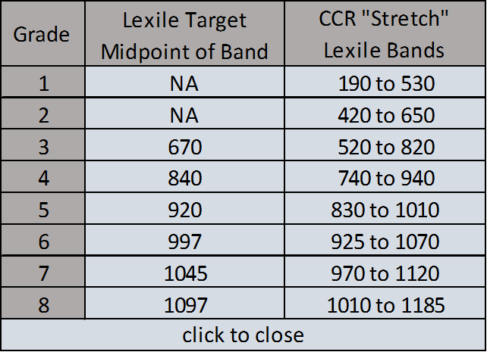
Readiness
20 pts
Content Mastery
30 %(pts)
Progress
35 %(pts)
Closing Gaps (Flags)
15 %(pts)
Readiness
20 %(pts)
Graduation Rate
(HS only)
Literacy - Lexile
33.33% (6.7 pts)
Attendance
33.33% (6.7 pts)
BTC
33.33% (6.7 pts)
Readiness focuses on literacy, attendance, and enrichment beyond the traditional core.
  Literacy measures the percentage of students demonstrating reading comprehension at or above the midpoint of the College and Career Ready “Stretch” Lexile Band for each grade level. FAY applies only to Lexile in this component.
  Attendance measures the percentage of students absent <10% of enrolled days. FAY does not apply.
  Beyond The Core – BTC – FAY does not apply.
    (Elementary) measures the percentage of students earning a passing score in fine arts or world language.
    (Middle) measures the percentage of students earning a passing score in fine arts, world language, physical education/health, or career exploratory.
Full Academic Year = student is enrolled 65% of calendar days from year start date to close of GADOE testing window. Only FAY students are included in some CCRPI calculations.
(click to close)
Source 4
R slide 1 of 2

Slide 19
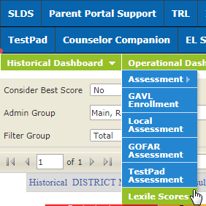
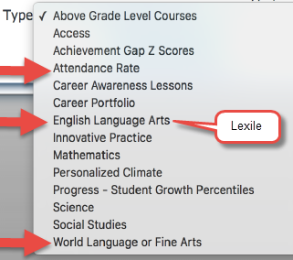
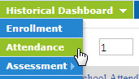
Data Sources for Readiness
Beyond the Core:
Pull data from
student information
system such as
PowerSchool
-Analyze data by multiple dimensions simultaneously,
-Compare across years, districts and schools,
-Save and share reports and auto-generated charts,
-Export to Excel or PDF
Log in to
GADOE Portal
1. Select:
- “CCRPI Reports”
- “Data Details” TAB
- The desired file
2. Download file in Excel format
3. Filter according to GADOE Calculation Guide

Slide 20
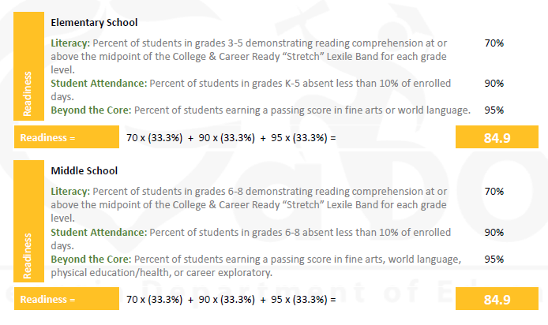
Example of Readiness
Readiness
20 %(pts)
(84.9) (.20) = 16.98 pts
out of 20
Source 4
R slide 2 of 2

Slide 21

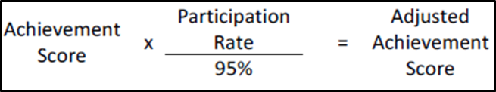

Glossary of Terms
  FAY (Full Academic Year): A FAY student is enrolled 65% of calendar days from the start date of the school year to the close date of the GADOE testing window. Only FAY students are included in some CCRPI calculations (Content Mastery & Literacy – Lexile, for example)
  Improvement Target: The CCRPI utilizes a target structure in which improvement or maintenance of high achievement levels is expected of all schools and all subgroups. The improvement target is an expected gain and not an absolute number; thus, it allows schools to start fresh each year and encourages schools to continue to focus on improvement.
N=15: Minimum subgroup size that must exist for scores to be included in CCRPI scoring and reporting.
Participation: GADOE requires that 95% of all students and 95% of any subgroup (N=15) participate in testing. If participation falls below 95%, scores will be adjusted.
SGP (Student Growth Percentile): Describes a student’s academic growth relative to Academic Peers. SGPs range from 1 to 99. Academic Peers are other students statewide with a similar score history.

Slide 22

Glossary of Terms
Subgroups: There are 10 reporting subgroup categories – All students, American Indian/Alaskan, Asian/Pacific Islander, Black, Hispanic, Multi-Racial, White, Economically Disadvantaged (ED), English Learner (EL), and Students with Disabilities (SWD).
Weighting: A kind of average. Instead of each score contributing equally to the final average, some scores contribute more “weight” than others. On the CCRPI, higher scores contribute more weight to the average than lower scores.

Slide 23
Bibliography
Source 1
  GaDOE. (January 19, 2018). Redesigned College and Career Ready Performance Index: Key Changes to the College and Career Ready Performance Index (CCRPI) Under the Every Student Succeeds Act. Accessed: February 26, 2018. Redesigned CCRPI
Source 2
  GaDOE. (January 19, 2018). Redesigned College and Career Ready Performance Index: College and Career Ready Performance Index (CCRPI) Indicators. Accessed February 26, 2018. Redesigned CCRPI Indicators
Source 3
  GaDOE. (January 19, 2018). Redesigned College and Career Ready Performance Index: Redesigned CCRPI Overview. Accessed February 26, 2018. Redesigned CCRPI Overview
Source 4
  GaDOE. (February 2018). Overview of the Redesigned CCRPI. Accessed February 26, 2018. Redesigned CCRPI Overview Presentation
Source 5
  GaDOE. (February 8, 2018). CCRPI Improvement Targets; Introduction for Principals, Accessed February 26, 2018. CCRPI Improvement Targets- Intro for Principals
  Source 6
  Harter, C. (Presentation at FDRESA, February 21, 2018). What’s New with the Accountability Reports.
Source 7
  GaDOE. (June 2017). A Guide to the Georgia Student Growth Model. Accessed February 26, 2018. SGP Guide
Source 8
  Smith, B. (Presentation at GaDOE SDE ILC, January 2018). Meeting the CCRPI Challenge. Meeting the CCRPI Challenge
Source 9
  GaDOE. (March 2017). Educating Georgia’s Future; Georgia’s State Plan for the Every Student Succeeds Act (ESSA. Accessed February 26, 2018. GA's ESSA Plan

Slide 24
Bibliography
Source 10
  Johnson, S. (Presentation to Georgia RESA Directors, March 15, 2018). On the Move.
Source 11
Swiggum, B. (Presentation at GADOE ILC, February 2018). Utilizing SLDS to Improve Student Achievement. Accessed April 16, 2018. Utilizing SLDS to Improve Student Achievement
  Source 12
  GADOE. (July 1, 2017). Five Steps or Less: Operational and Historical Dashboard. Accessed May 15, 2018. Five Steps or Less
  Source 13
  GADOE. (June 28, 2017). Georgia’s Systems of Continuous Improvement: Systems, and Structures Descriptions. Accessed May 15, 2018. GA SCI Systems and Structures Descriptions
  Source 14
GADOE SDE. (May 2018). System for Effective School Instruction: A Model for School Leaders to Build an Effective Instructional Program. Accessed May 18, 2018. System for Effective School Instruction
Source 15
GADOE SDE. (July 2016). System for Effective School Instruction Self-Assessment Checklist. Accessed May 15. Self-Assessment Checklist
Source 16
Rahming, N. (Presentation at GADOE ILC, February 2018). Using the Georgia’s Continuous System of Improvement for School-based Planning.
Source 17
GADOE SDE. (May 2018). Elementary Calculation Guide; Middle School Calculation Guide ; High School Calculation Guide

Slide 25
Explore the 2019 CCRPI for
Elementary and Middle School
While FDRESA strives to make this information as timely and accurate as possible, it makes no guarantee about the accuracy, completeness, or adequacy of the content, and expressly disclaims liability for errors and omissions. No warrant of any kind, implied, expressed or statutory is given with respect to the information and related linked resources.
25

